Slide 1


Rodan
End-to-End Optical Music Recognition Workflow
Alex Daigle
Notes:
Where we will explore the full end to end OMR workflow in Rodan.

Slide 2



Index
What is Rodan
How to create a workflow
A full end-to-end workflow
Developments

Slide 3

What is Gamera?
First presented in 2001
It is a toolkit for creating image recognition systems
https://gamera.informatik.hsnr.de/publications/index.html
https://www.sideshow.com/storage/product-images/903254/gamera_gamera-3-revenge-of-iris_feature.jpg

Slide 4
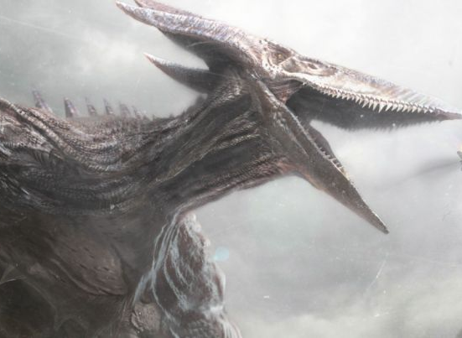
What is Rodan?
Workflow Engine
In the Browser
Open Source
https://cosmicbook.news/sites/default/files/styles/768/public/rodan-teased-godzilla-king-monsters-trailer.jpg?itok=TBYBjy6V&timestamp=1543873424
Notes:
Rodan is a tool that allows us to identify information on images, in other words it helps us perform image recognition tasks. Rodan can wrap together the jobs we build here and have the workflow act upon resources we upload. A workflow can be one or many jobs connected together.
It's standing on the shoulders of Gamera, jobs in rodan have been built using the Gamera toolkit.
You do not need to install anything, it's in the browser for you, and it gets updated nightly for you.
It’s open source, if you have any ideas you can look at the code and let us know.

Slide 5
How to create a workflow
Upload a resource
Notes:
Fast Collaboration of resources

Slide 6
How to create a workflow
Upload a resource
Create a workflow
Notes:
It uses the Diva viewer for viewing all almost image formats

Slide 7
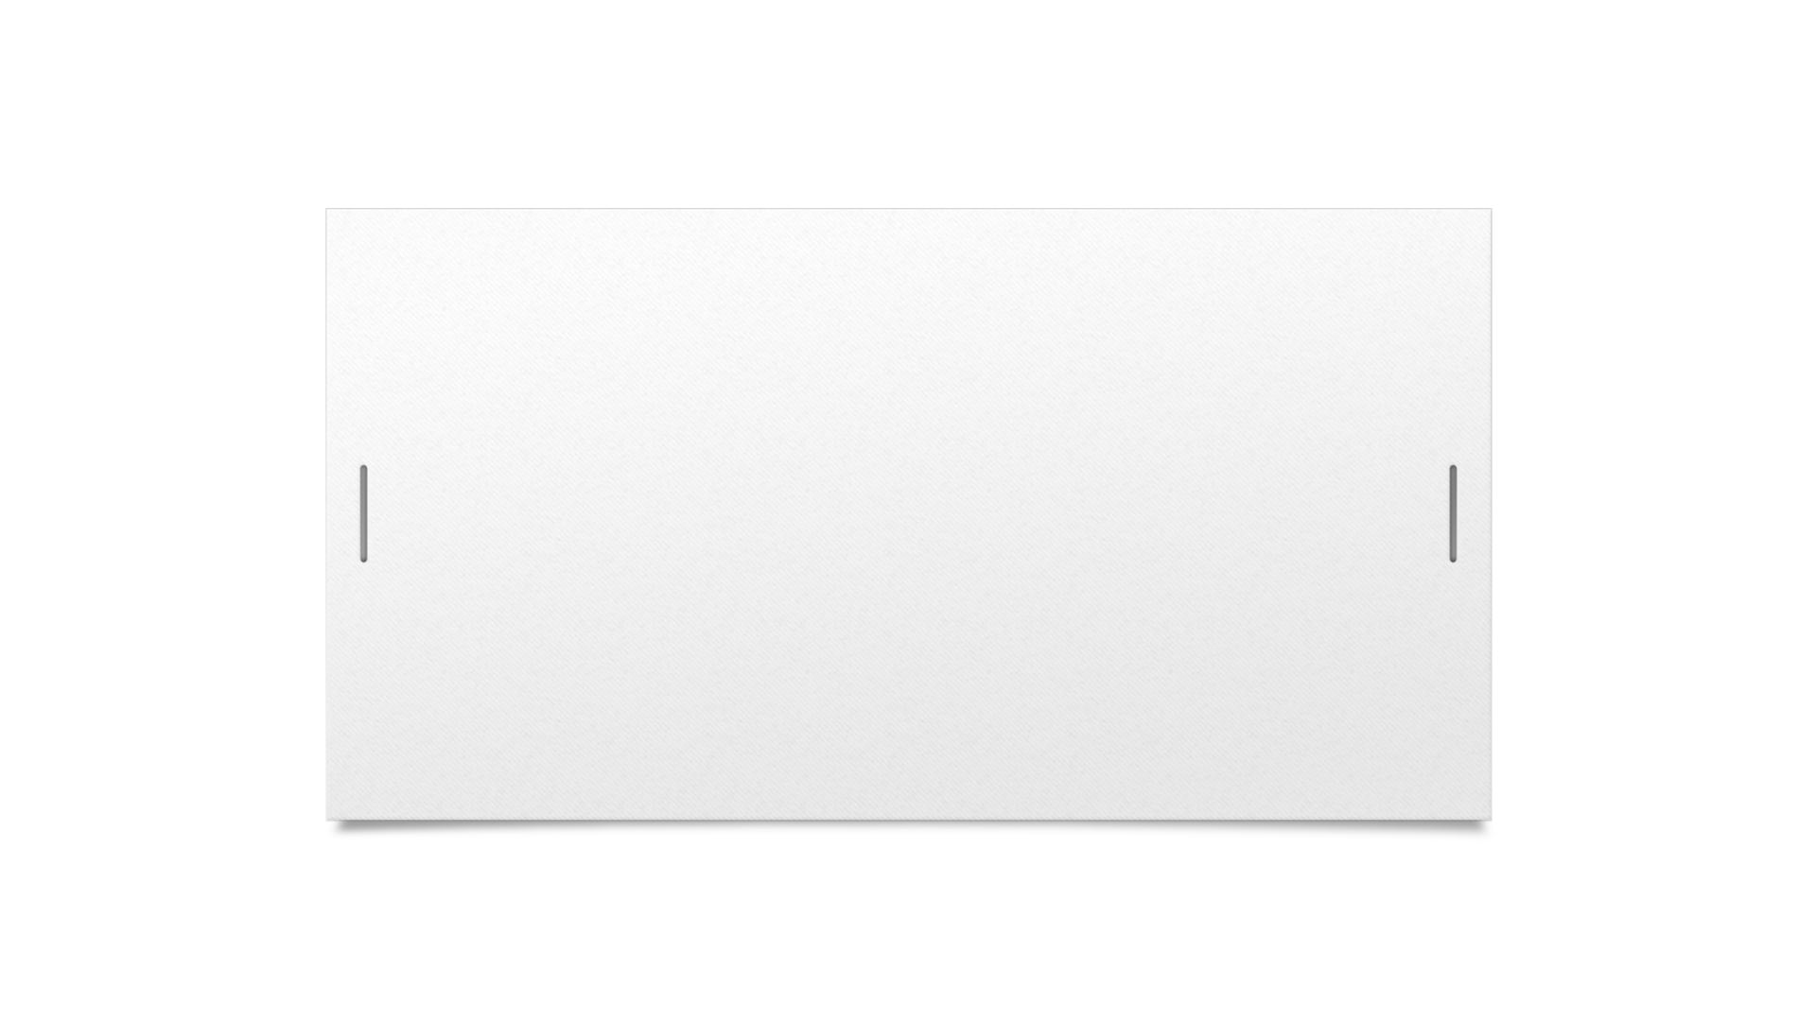
How to create a workflow
Upload a resource
Create a workflow
Add jobs
Notes:
It uses the Diva viewer for viewing all almost image formats

Slide 8
How to create a workflow
Upload a resource
Create a workflow
Add jobs
Connect jobs together

Slide 9
How to create a workflow
Upload a resource
Create a workflow
Add jobs
Connect jobs together
Customize a jobs settings

Slide 10
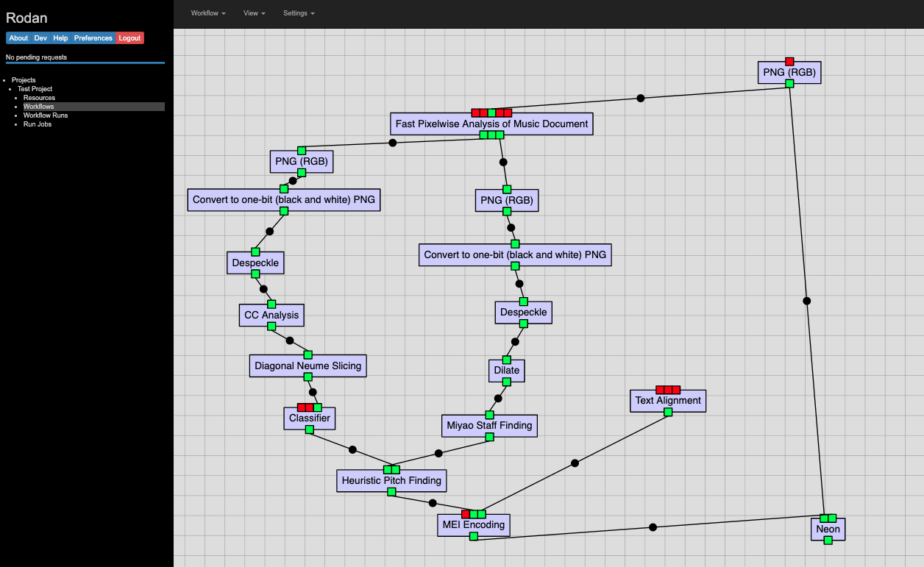

Slide 11
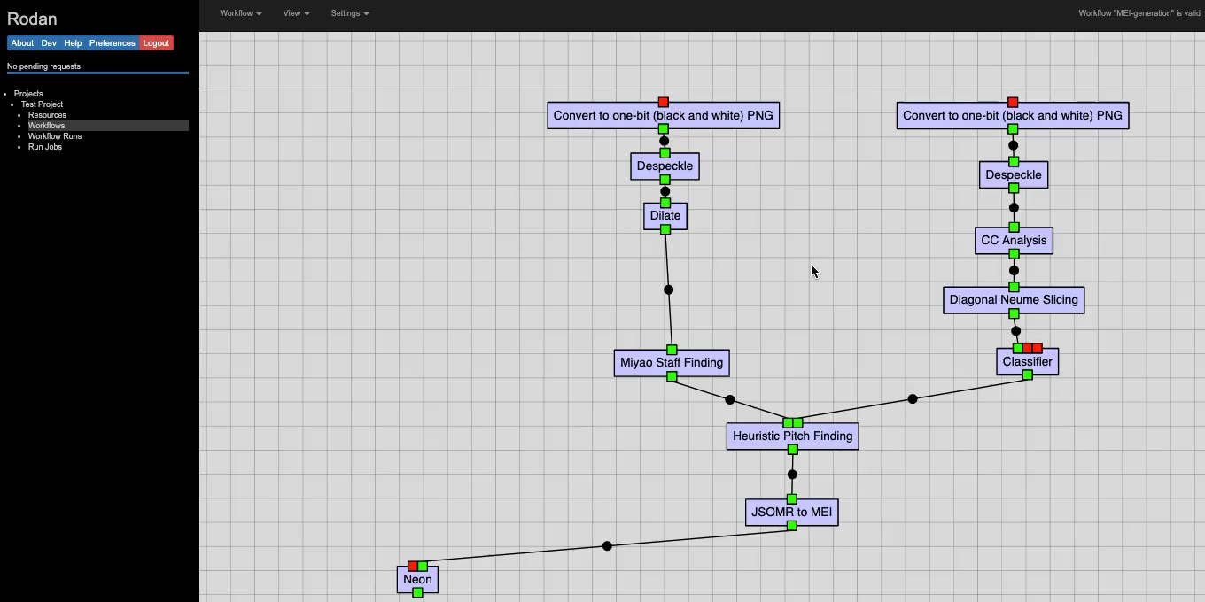

Slide 12
New Features
Scalability
Job Queue
Scripting Library for batch processing

Slide 13

Thank You
Alastair Porter
Alex Daigle
Andrew Hankinson
Andrew Horwitz
Anton Khelou
Brian Stern
Deepanjay Roy
Gabriel Vigliensoni
Ling-Xiao Yang
Matan Gover
Nicky Mirfallah
Peter Henderson
Rajarshi Rivu Khoda
Ruth Berkow
Ryan Bannon
Wei Gao
Wendy Liu
YiHong Luo

